Slide 1

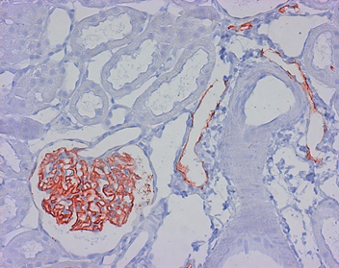
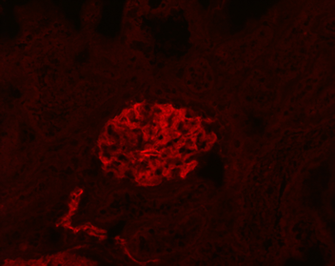
ReliaTech GmbH
Mouse anti-rat Podoplanin (#LF3(B7)D5B3)
(Cat# 104-M40)
Figure 1: Staining of lymphatic endothelial cells and podocytes in normal rat renal corpusle (paraffin-embedded tissue-sections fixed in formalin) with anti-rat Podoplanin [Cat# 104-M40].
Figure 2: Immunofluorescence staining of lymphatic endothelial cells and podocytes in normal rat renal corpusle (paraffin-embedded tissue-sections fixed in formalin) with anti-rat Podoplanin [Cat# 104-M40].
http://www.reliatech.de / orders@reliatech.de

